Slide 1
Azure Data Lake & Factory

Slide 2




The session will span for 5 days & it is mandatory to attend all the days.
Self-Paced labs have been developed & access will be shared during the session.
The “Azure Subscriptions” are limited & pre-sent via email to only a registered audience.
The remaining audience can participate in the leaning. However, it DOES NOT come with “Azure Subscriptions” & request users to arrange on their own.
A proctor will be available to take your queries via “Chat” window. Kindly “MUTE” and do not disturb the presenter.
The sessions are recorded. Will be made available through LMS at the end of series.
Note: More trainings on the same & similar topics would be delivered in near future. Keep your options open.
Guidelines for the event

Slide 3
Questionnaire
To be taken after each section .
Request you to ask the questions in Chat window .
Will respond to them after a logical break point in each topic.
This would make the workshop interesting and approachable .
Request not to use Phones or get distracted for next 3 hours .

Slide 4
Expected Outcome!
Azure Data Ecosystem – When to use what !
Architectural Standards & Best Practices in Azure .
Hands on Project ready confidence.
Tackling Real world challenges in Azure Data Platform
Real world use cases and architectures for huge clients.

Slide 5
Data Ecosystem

Slide 6



Information Management
Information Management
Data Sources
Data Factory
Apps
Data Catalog
Event/IoT Hubs
Sensors and devices
Data
Notes:
T: Information Management includes Data Factory, Data Catalog, and Event Hubs.

Slide 7
Big Data Stores
Information Management
Big Data Stores
Data Sources
Data Factory
Data Lake Store
Data Catalog
SQL Data
Warehouse
Apps
Event Hubs
{ }
Cosmos DB
Sensors and devices
Data
Notes:
T: Azure provides a variety of storage options, including Blobs. Here we’ll dive into the two main storage options with Cortana Intelligence, starting with Data Lake Store.

Slide 8

Machine Learning and Analytics
Information Management
Big Data Stores
Machine Learning and Analytics
Data Sources
Data Factory
Data Lake Store
Machine Learning
Data Catalog
SQL Data
Warehouse
Data Lake Analytics
Apps
HDInsight
(Hadoop and Spark)
Event Hubs
{ }
Cosmos DB
Stream Analytics
Sensors and devices
Azure Analysis Services
Azure Time Series Insight
Data
Intelligence
Notes:
T: Advanced analytics services are where data starts turning into insight that drives intelligent action.

Slide 9
Intelligence
Information Management
Big Data Stores
Machine Learning and Analytics
Intelligence
Data Sources
Data Factory
Data Lake Store
Machine Learning
Cognitive Services
Data Catalog
SQL Data
Warehouse
Data Lake Analytics
Bot Service
Apps
HDInsight
(Hadoop and Spark)
Event Hubs
{ }
Cosmos DB
Cortana
Stream Analytics
Sensors and devices
Azure Analysis Services
Azure Time Series Insight
Data
Intelligence
Notes:
T: Our intelligence capabilities fall into three areas – Cognitive Services, Bot Framework and Cortana.

Slide 10

Transform data into intelligent action
Information Management
Big Data Stores
Machine Learning and Analytics
Intelligence
Data Sources
People
Data Factory
Data Lake Store
Machine Learning
Cognitive Services
Data Catalog
SQL Data
Warehouse
Data Lake Analytics
Bot Service
Apps
Web
Event Hubs
HDInsight
(Hadoop and Spark)
{ }
Cosmos DB
Cortana
Mobile
Apps
IoT Hubs
Stream Analytics
Dashboards & Visualizations
Bots
Sensors and devices
Azure Analysis Services
Azure Time Series Insight
Power BI
Automated Systems
Data
Intelligence
Action
Notes:
T: Cortana Intelligence provides everything you need to transform your organization’s data into intelligent action. Next, let’s take a look at another demo.

Slide 11


Build applications that understand people
Intelligence
Vision
Speech
Language
Knowledge
Search
Cognitive Services
Computer Vision
Speaker Recognition
Text Analytics
Academic
Bing Web Search API
Content Moderator
Bing Speech
Bing Spell Check
Entity Linking
Bing Image Search API
Bot Service
Face
Custom Speech Service
Web Language Model
Knowledge Exploration
Bing Video Search API
Cortana
Emotion
Linguistic Analysis
Recommendations
Bing News Search API
Video
Language Understanding
QnA Maker
Bing Auto Suggest API
Translator
Faces, images, emotion recognition and video intelligence
Spoken language processing, speaker recognition, custom speech recognition
Natural language processing, sentiment and topics analysis, spelling errors
Complex tasks processing, knowledge exploration, intelligent recommendations
Bing engine capabilities for Web, Autosuggest, Image, Video and News
Notes:
What’s incredibly unique is the intelligence capabilities Cortana Intelligence offers, building on years of Microsoft research and innovation. These capabilities enable our customers to build intelligent systems and agents that can augment their organizational capabilities. For example, organizations can interact with customers and stakeholders in new ways and infer intent with vision, face, speech, text and sentiment analysis to customize responses and drive appropriate actions.
Microsoft Cognitive Services, a set of cloud services, APIs and SDKs that enable organizations to build intelligent systems that can see, hear, interpret and understand the world around you and makes all applications more intelligent, engaging and discoverable. Cognitive Services expands the existing perceptual intelligence capabilities like Vision, Speech, Text and Face detection to include new cognitive capabilities such as Emotion and customized Language Understanding. What we showcased with www.how-old.net is one example of what is possible.
T: Next, Bot Service.

Slide 12
Azure Storage Accounts

Slide 13
Azure Storage Components:
Blobs – Highly scalable, REST based cloud object store
Tables – Massive auto-scaling, NoSQL store
Queues – Reliable messaging at scale for cloud services
Disks – Persistent Premium & Standard disks for Azure IaaS VMs
Files – SMB 3.0 access to Azure Storage
Azure Import/Export – Ship data in HDD
AZCopy – High-performance data upload , download, & copy

Slide 14
Durability Options
Locally Redundant Storage (LRS)
Stores 3 replicas of the data within a single zone (facility) in a single region
Provides data durability for disk, node and rack failures
Geo Redundant Storage (GRS)
Stores 6 replicas of the data across two regions (3 in each region)
Provides additional durability to protect data against major regional natural disasters (e.g., tornado, hurricane, fire, etc, destroying a whole region)
Updates across regions are performed asynchronously
Zone Redundant Storage (ZRS)
Stores 3 replicas of the data across multiple zones (facilities) within a single region or across regions
Provides additional durability to protect data against zone failures (e.g., fire burning down a facility)

Slide 15
Access Control
Symmetric Shared Key AuthN
Trusted service that owns the storage accounts
Shared Access Signature (SAS) Delegated AuthZ
3rd party services
Mobile device applications
Restricted access for services
Allow client applications to directly communicate with Storage rather than scaling a proxy web service
Public (Blob service only)
CDN access
Browser based access

Slide 16
Approach of Data is Changing !!!
Data Lake

Slide 17
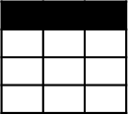
Evolving Approaches to Analytics EDWs to Data Lakes
Extract
Transform
Load
OLTP
…
EDW
(SQL Svr, Teradata, etc)
Original Data
ETL Tool
(SSIS, etc)
Transformed Data
BI Tools
ERP
LOB
Data Marts
Data Lake(s)
Dashboards
Apps

Slide 18
Evolving Approaches to Analytics EDWs to Data Lakes
Extract
Transform
Load
OLTP
…
EDW
(SQL Svr, Teradata, etc)
Original Data
ETL Tool
(SSIS, etc)
Transformed Data
BI Tools
ERP
LOB
Data Marts
Data Lake(s)
Dashboards
Devices
Social
Ingest (EL)
Apps
Sensors
Original Data
Web

Slide 19
Evolving Approaches to Analytics EDWs to Data Lakes
Extract
Transform
Load
OLTP
…
EDW
(SQL Svr, Teradata, etc)
Original Data
ETL Tool
(SSIS, etc)
Transformed Data
BI Tools
ERP
LOB
Data Marts
Data Lake(s)
Dashboards
Devices
Social
Ingest (EL)
Scale-out Storage & Compute
(HDFS, Blob Storage, etc)
Apps
Sensors
Original Data
Web
Streaming data
Transform & Load

Slide 20
Evolving Approaches to Analytics EDWs to Data Lakes
Extract
Transform
Load
OLTP
…
EDW
(SQL Svr, Teradata, etc)
Original Data
ETL Tool
(SSIS, etc)
Transformed Data
BI Tools
ERP
LOB
Data Marts
Data Lake(s)
Dashboards
Devices
Social
Ingest (EL)
Scale-out Storage & Compute
(HDFS, Blob Storage, etc)
Apps
Sensors
Original Data
Web
Streaming data
Transform & Load

Slide 21
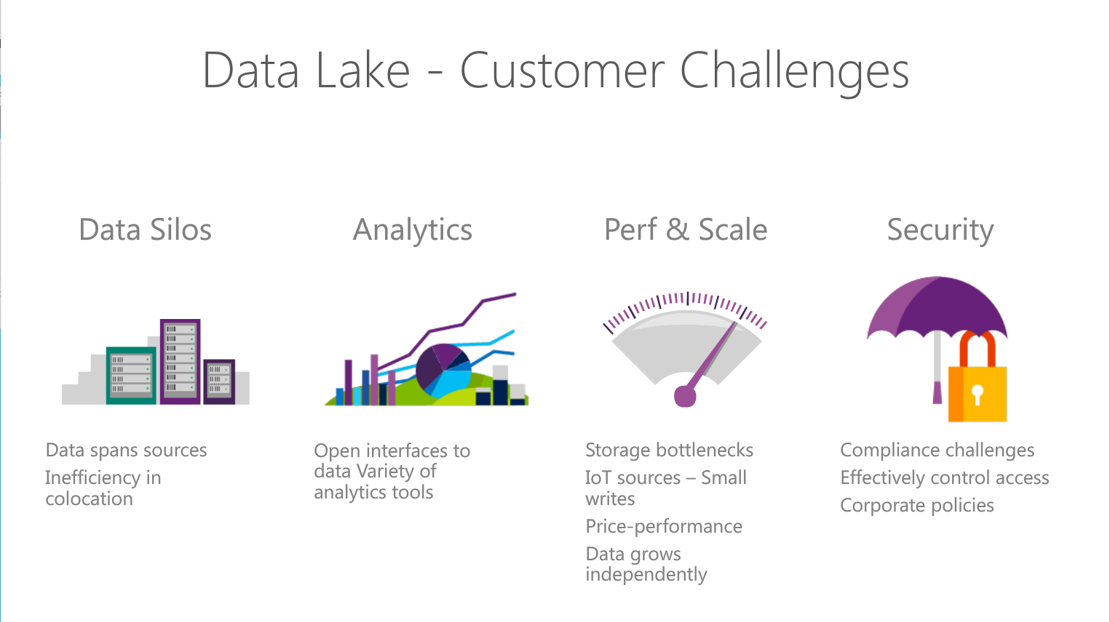
Notes:
Objetive – explain what are the Customer challeges that Azure Data Lake solution addresses
Read through the points.

Slide 22
The Intelligent Lake
Petabytes of Data + Intelligence
Data Lake Store
No-limits data Lake
Petabyte-sized files
Trillions of objects
Scalable I/O for parallel analytics
Enterprise-grade Security
Data Lake Analytics
Analytics job service
Scale instantly
Scale per job
Infused with Artificial Intelligence

Slide 23
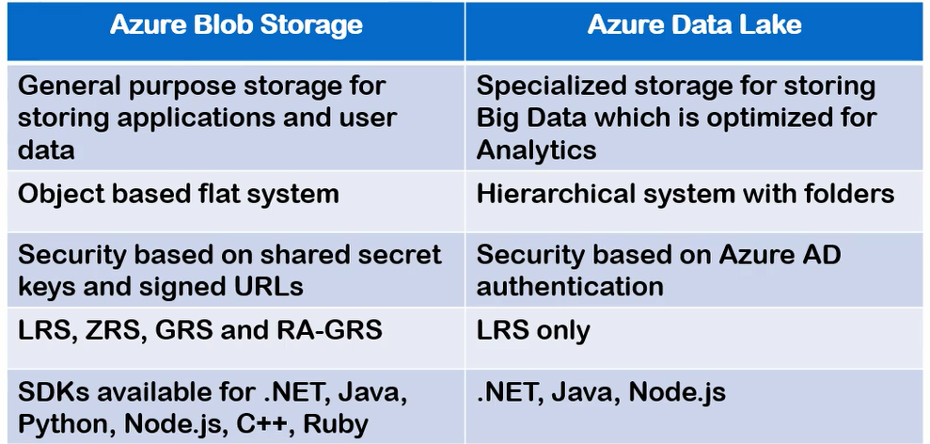
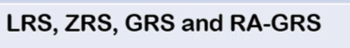
Azure Data Lake Storage Gen 1 Vs BLOB

Slide 24
ADLS Gen1 + BLOB = ADLS Gen 2
Use | Data Lake Store | Blob Storage | Data Lake Gen 2
Hot/Cold Storage Tiers | No | Yes | Yes
Redundant Storage | No | Yes | Yes
AD Security | Yes | No | Yes
HDFS Compatible | Yes | No | Yes

Slide 25
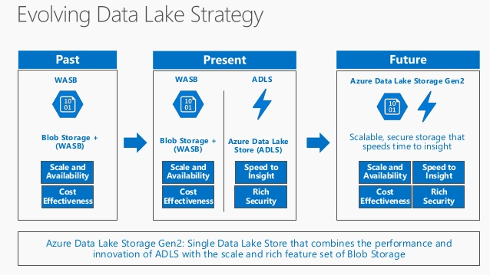
ADLS Gen1 + BLOB = ADLS Gen2

Slide 26
Azure Data Lake Use Cases

Slide 27
Retail Scenario Implementation
ON-PREMISES
CLOUD
CONSUMPTION
Massive Archive
Web Portals
Initial one time import
“Landing Zone”
Data Lake Store
DW (many instances)
On-Prem HDFS
Mobile Apps
via AzCopy
Curated Data
Data is portioned into multiple SQL DWs (one per data consumer. Several hundred consumers)
Power BI
Incremental
updates
Experimentation
Machine Learning
A/B testing at scale. Drive changes based on actual
Customer behavior
Do ML at Scale (Customer Segmentation & Fraud Detection)
Active Incoming Data
Jupyter
Notebooks
Notes:
Discuss how the previous scenario can fir into a concrete scenario for retail sector .
Here we use ADLS as store to where dat is uploaded from on-premise HDFS cluster and it analysed to extract additional insight using machine learning techniques
To do fraud prediction or customer segmentation. The data can then be suploaded to SQL data warehose to which various clients connect to conume data.

Slide 28
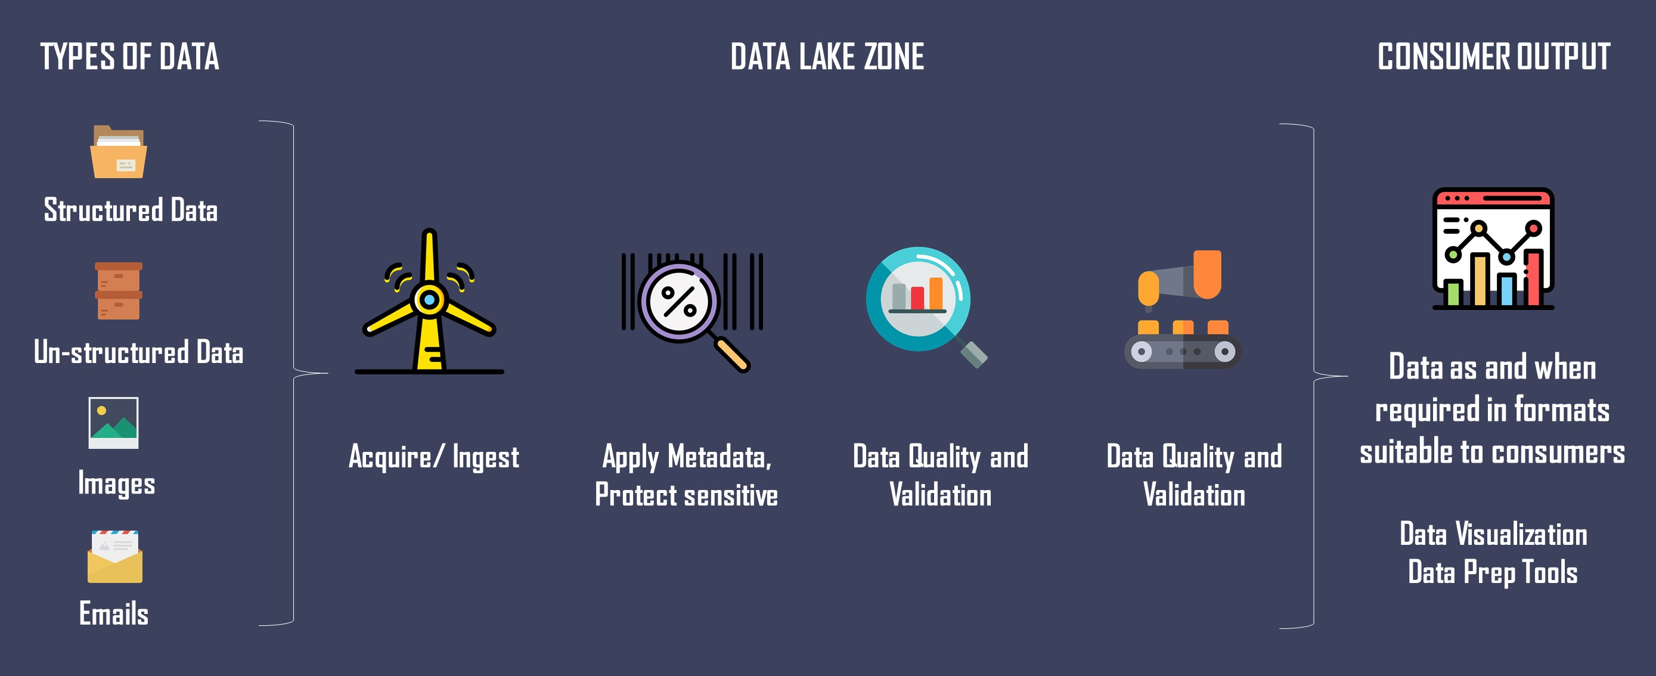
Zones in

Slide 29
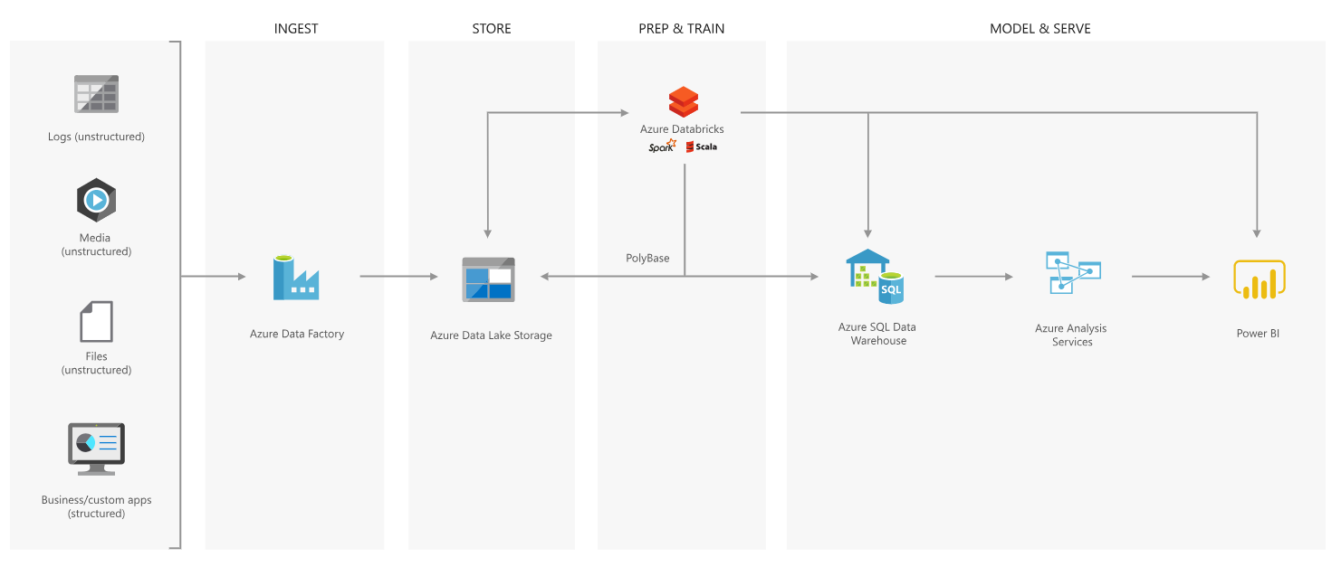
Best Practices – Modern Data Warehouse

Slide 30
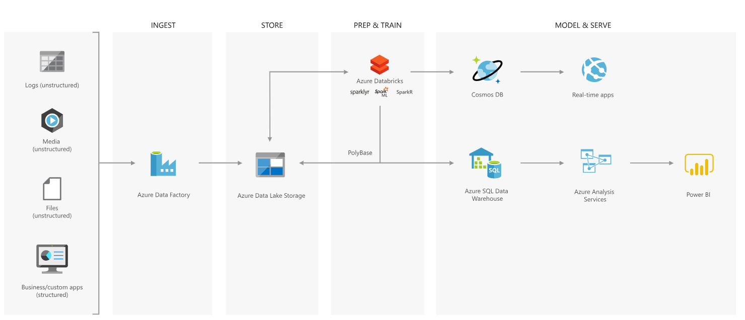
Advanced Analytics Approach

Slide 31

Azure Data Lake Store
Notes:
Lets have a look at the Data Lake Store service in more detail

Slide 32

The Data Lake Approach
Ingest all data regardless of requirements
Store all data
in native format without schema definition
Do analysis
Using analytic engines like Hadoop and ADLA
Devices
Social
Batch queries
LOB applications
Video
Devices
Interactive queries
LOB applications
Social
Sensors
Real-time analytics
Web
Sensors
Video
Machine Learning
Relational
Web
Clickstream
Data warehouse
Relational
Clickstream
Notes:
Motivation – explain that ALS Store is Load Transform and Extract rather than ETL. You essentially postpone the schema definition until the extraction time.
A data lake is an enterprise wide repository of every type of data collected in a single place. Data of all types can be arbitrarily stored in the data lake prior to any formal definition of requirements or schema for the purposes of operational and exploratory analytics. Advanced analytics can be done using Hadoop, Machine Learning tools, or act as a lower cost data preparation location prior to moving curated data into a data warehouse. In these cases, customers would load data into the data lake prior to defining any transformation logic.
This is bottom up because data is collected first and the data itself gives you the insight and helps derive conclusions or predictive models.

Slide 33
Security Considerations

Slide 34
Data Protection
Protect the data at rest
Protect the data in transit
Support browser cross-domain access
Control who can access data
Audit storage access

Slide 35
Understand storage account keys
Data is generated or consumed by custom applications
The applications are written in various languages.
Create authorized apps in Active Directory to control access to the data in blobs

Slide 36
Understand shared access signatures
You shouldn't share storage account keys with external third-party applications
For untrusted clients, use a shared access signature (SAS)
Types of shared access signatures
service-level shared access signature
account-level shared access signature

Slide 37
Control network access to your storage account
Storage accounts accept connections from clients on any network
To limit access to selected networks, you must first change the default action.
You can restrict access to specific IP addresses, ranges, or virtual networks

Slide 38
Understand Advanced Threat Protection for Azure Storage
Often any protection only shows you that an intrusion has already occurred.
What you really want is a way to be notified when suspicious activity is happening
Advanced Threat Protection, detects anomalies in account activity
It then notifies you of potentially harmful attempts to access your account.

Slide 39


Questionnaire !!!

